Slide 1

Add Team Members Names here

Slide 2
UN SDG Goal
Topic - Technology
Team member - Leka Shree J & Sri Ram M S
Registration number - URK20AI1051 & URK20AI1043
K-Mail – lekashree@karunya.edu.in & sriram20@karunya.edu.in
GitHub Repository Link - https://github.com/isri-ram/DataScience-Hackathon-KHacks

Slide 3
TABLE OF CONTENTS
Problem Statement And Mapping With UN SDG
Solution Found And Dataset Used
Data Analysis And Model Building
Insights Gained And References Used

Slide 4
PROBLEM STATEMENT
Objective is to build a model to predict future outcomes for the given Stock of Science and Technology Personnel.
This goal aims to promote sustainable industrialization, foster innovation, and build resilient infrastructure.
Developing a model to predict future outcomes for Science and Technology Personnel requires the use of technology and innovation to create a sustainable solution that can contribute to the overall growth and development of the industry.
By improving the stock of Science and Technology Personnel, the industry can advance and drive economic growth, leading to the achievement of SDG 9.

Slide 5
SOLUTION
The linear regression model is trained on the training data, and the predictions are made on the testing data using the predict function. The predicted values are then printed. Finally, the performance of the model is evaluated using mean squared error and mean absolute error, which provides a measure of how well the model is able to predict the target variable based on the input features.
The model is used to forecast future demand for science and technology personnel, which could help companies and organizations better plan their hiring and training strategies.
if the model predicts a decrease in the number of Science and Technology personnel, organizations may need to adjust their recruitment strategies or consider outsourcing certain tasks.
This model can predict the future outcomes with a certain level of accuracy.

Slide 6
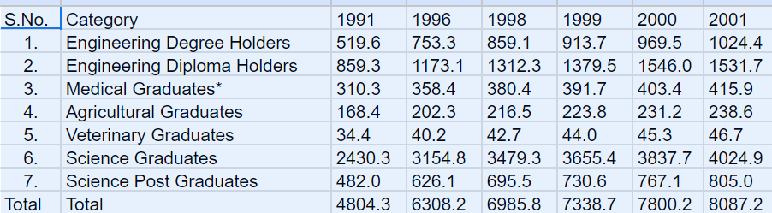
DATASET USED
The given dataset provides information about the number of graduates from various academic fields for the years 1991 to 2001. The fields include Engineering Degree holders, Engineering Diploma holders, Medical Graduates, Agricultural Graduates, Veterinary Graduates, Science Graduates, and Science Post Graduates.
The data shows that the number of graduates has generally increased over the years across all fields. In 1991, the total number graduates was 4804.3, which increased to 8087.2 in 2001.Among the fields, Science Graduates had the highest number of graduates in all years, followed by Engineering Diploma Holders and Engineering Degree Holders. Medical Graduates had the lowest number of graduates compared to other fields.
The data can be useful in studying trends in the number of graduates from different fields over the years and can provide insights into the demand and supply of graduates in different fields.

Slide 7
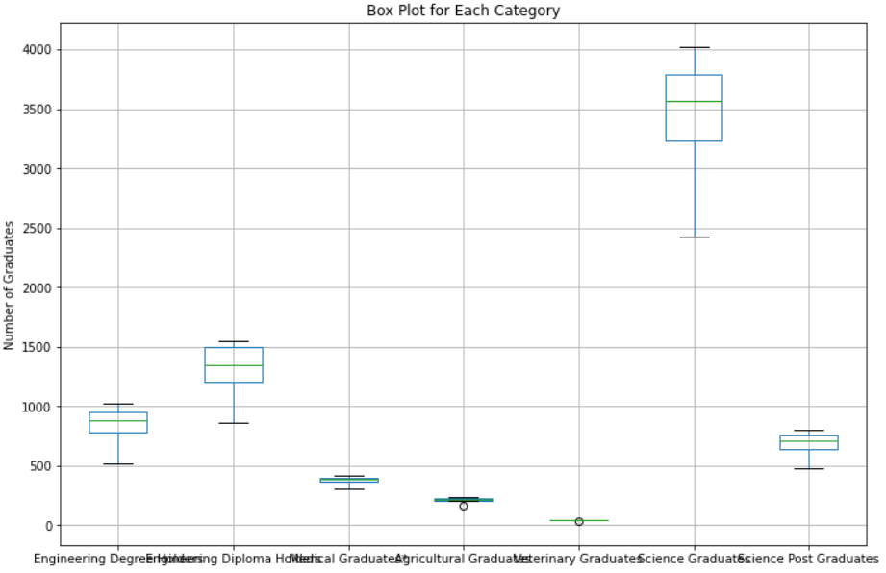
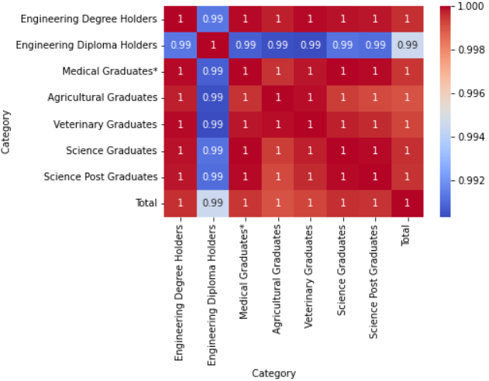
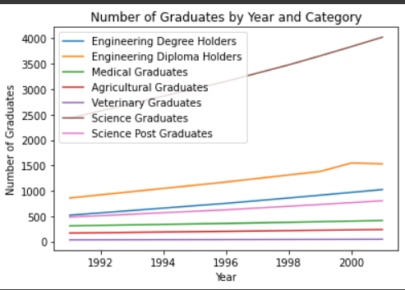
DATA VISUALIZATION
Correlation graph:
A correlation graph is used to visually represent the relationship between two variables. The correlation graph is a useful tool in data analysis because it can help to identify patterns and trends in the data
Box plot:
is a graphical representation of a distribution of numerical data. It displays the median, quartiles, and extreme values (outliers) of a set of data in a compact and efficient manner
Line graph:
They are used to represent how a variable changes over time or over another continuous range of values

Slide 8
MODEL BUILDING
The dataset has been split into Training and testing data
Tools used is colab and the algorithm used is Simple Linear regression
Simple linear regression is a statistical technique that is used to analyze the relationship between two variables: a dependent variable (also known as the response variable) and an independent variable (also known as the predictor variable)

Slide 9

PERFORMANCE METRICS
Mean Squared Error:
MSE is calculated as the average of squared
differences between the predicted values of the model and the actual values of the data set. A lower MSE indicates a better fit of the model to the data.
Mean Absolute Error:
It is calculated as the average of the absolute differences between the predicted and actual values, without considering the direction of the difference.

Slide 10
INSIGHTS GAINED AND REFERENCES USED
Based on the given problem statement, the objective is to develop a predictive model for the stock of science and technology personnel in the future. This could involve analyzing historical data on the stock of personnel in this field, as well as other relevant economic and demographic indicators, to identify trends and patterns that may help predict future outcomes.
References used to support the development of a predictive model for science and technology personnel could include a variety of data sources, such as census data, educational attainment data, and other relevant economic and demographic indicators. The accuracy and reliability of the predictive model would depend on the quality and relevance of the data used, as well as the appropriateness of the chosen statistical or machine learning technique.

